Slide 1


Slide 2
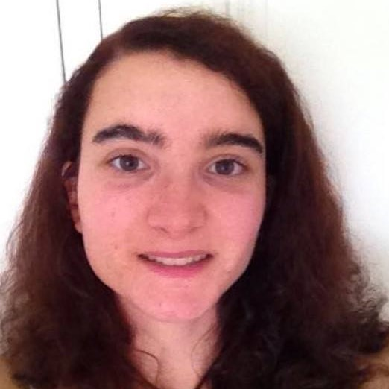
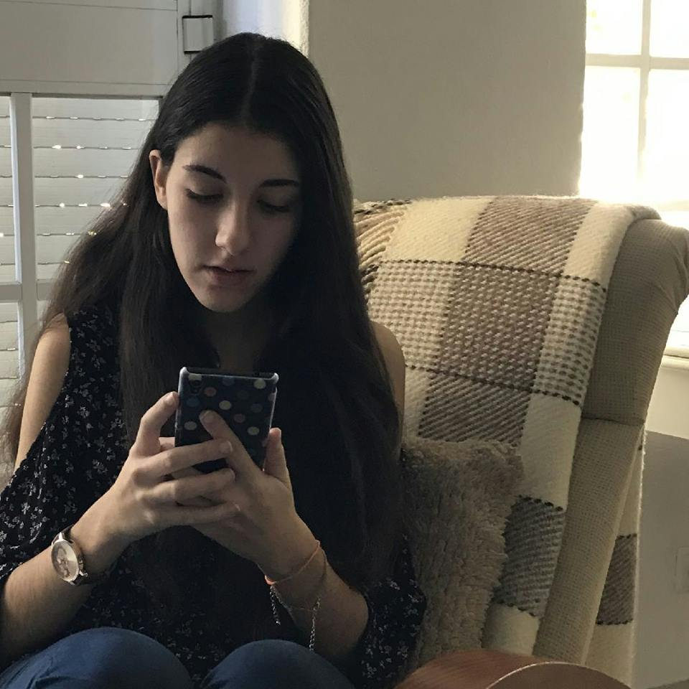
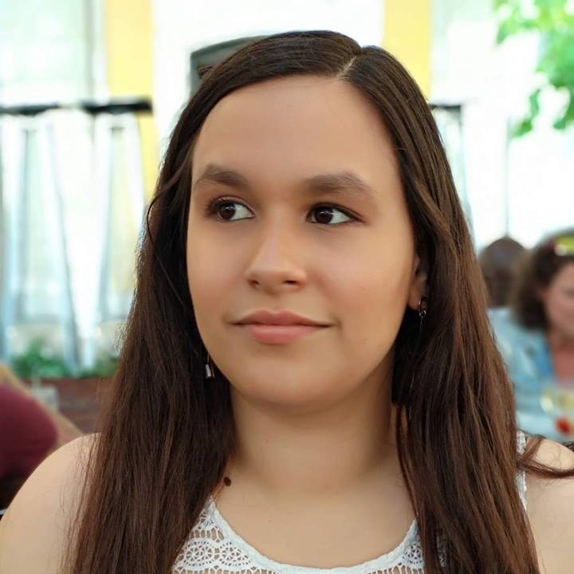
Bárbara Ramalho
GROUP MANAGER
Mafalda Morgado
RESEARCHER
Nádia Mourão
DESIGNER

Slide 3

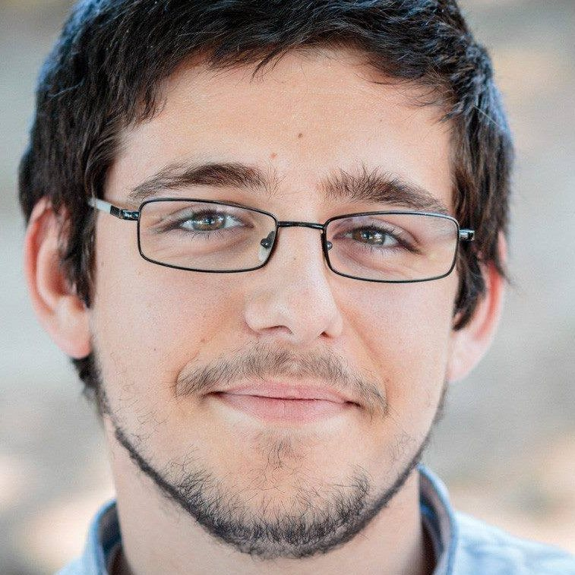
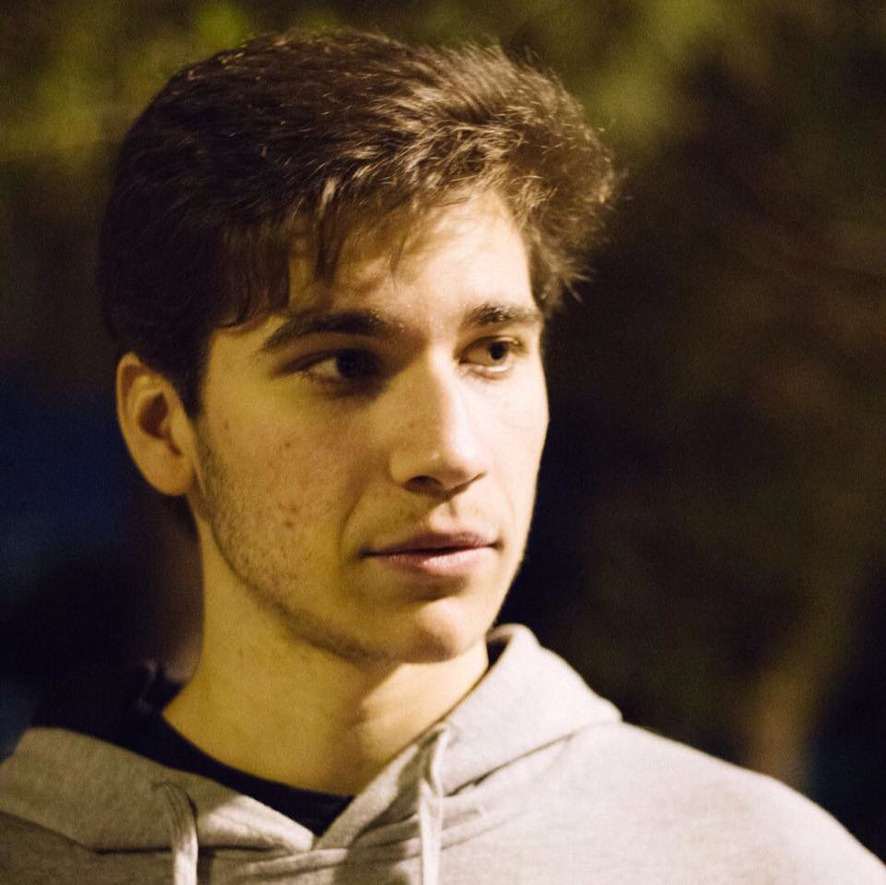
Carolina Veloso
FRONT-END DEVELOPER
Hugo Lencastre
BACK-END DEVELOPER
André Vieira
BACK-END DEVELOPER

Slide 4

Overview & Background

Slide 5
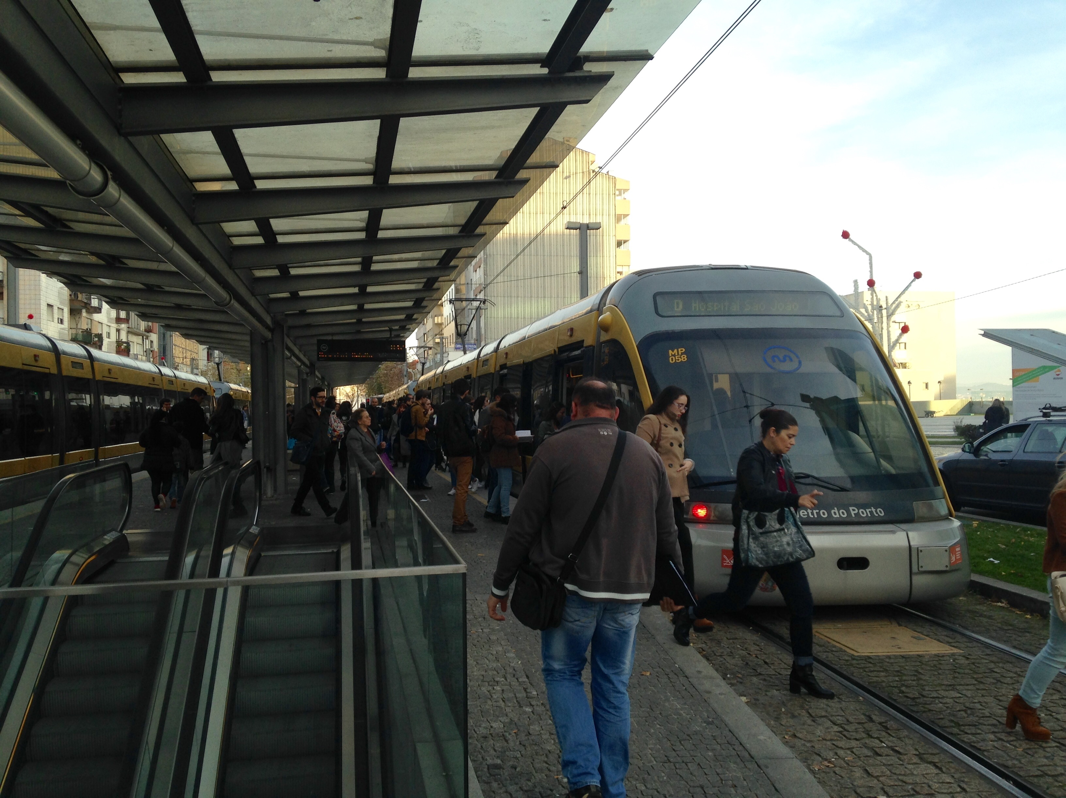
Control fare evasion

Slide 6

SOLUTION CONCEPT

Slide 7
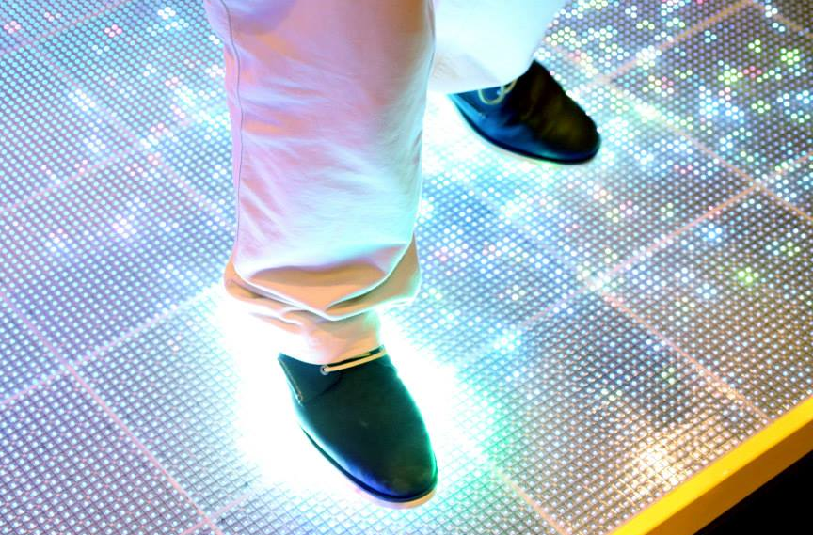
INTERACTIVE PLATFORM

Slide 8

COLOUR CODE
Green
Valid Ticket
Orange
Red
Invalid Ticket

Slide 9


PLATFORM – ARRIVAL

Slide 10
PLATFORM – GOING TO VALIDATE

Slide 11
PLATFORM - VALIDATING

Slide 12
PLATFORM - VALID

Slide 13
PLATFORM – WALK FREELY

Slide 14
INVALID TICKET

Slide 15
PLATFORM – FAILS TO VALIDATE

Slide 16
PLATFORM - INVALID

Slide 17

VIDEO

Slide 18

USER RESEARCH

Slide 19
USER RESEARCH
Understand our users
Enquiry
Field observations
Flash Interviews
One-on-one interviews
Focus groups

Slide 20
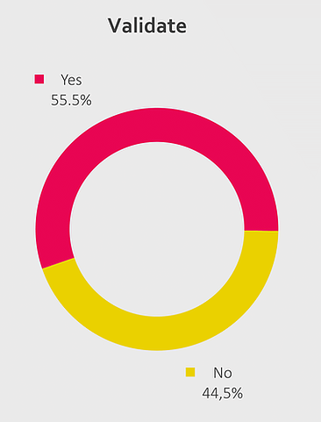
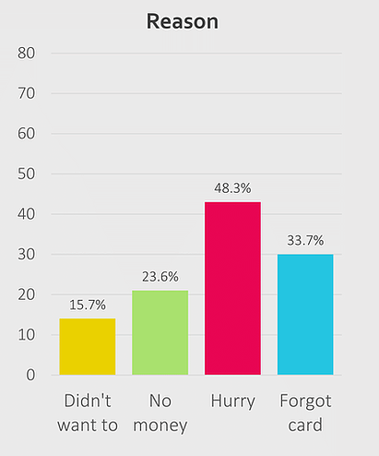
RESULTS

Slide 21
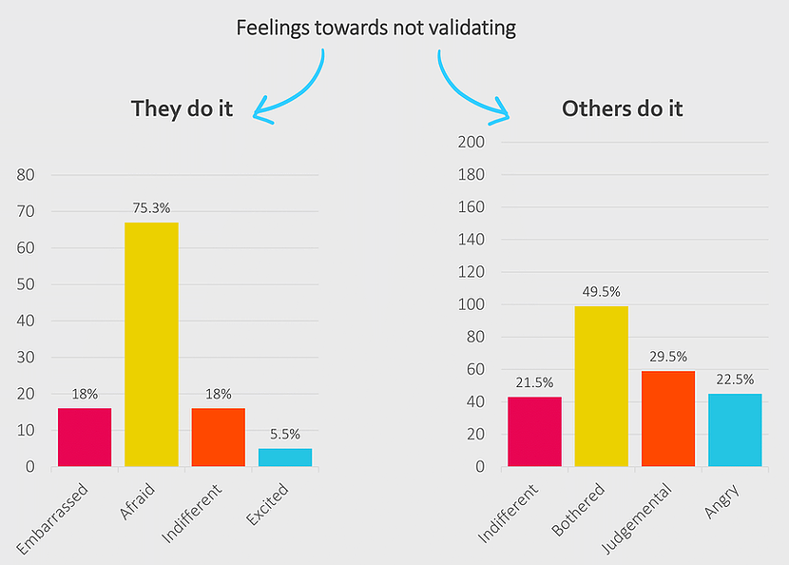

Slide 22

FEEDBACK
Main reason why people don’t validate
Because they forgot or were in a hurry

Slide 23

DESIGN PROCESS

Slide 24


DESIGN PROCESS
TESTING
REFINING

Slide 25
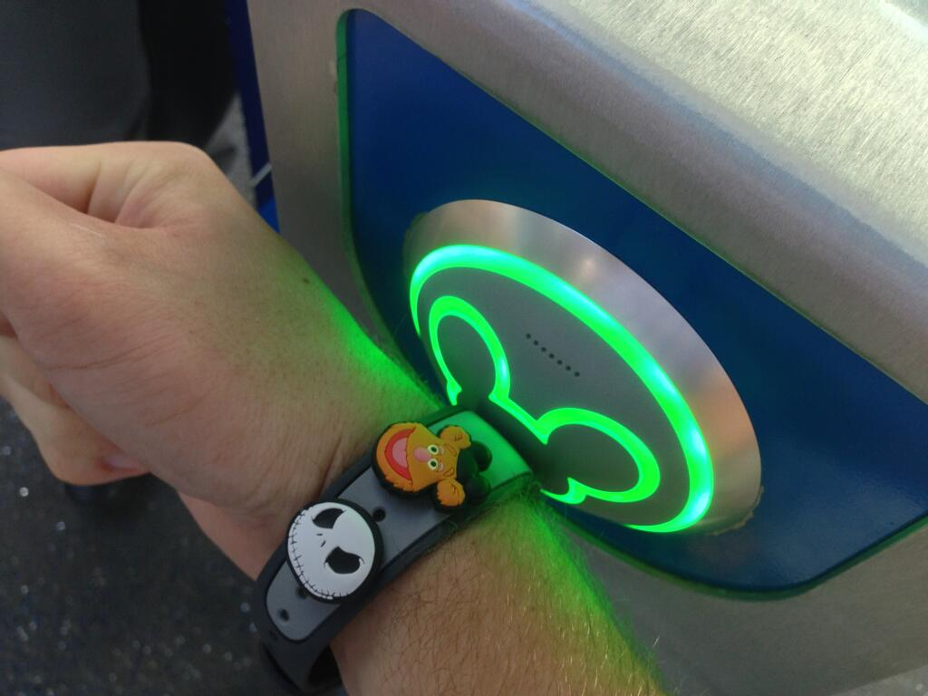
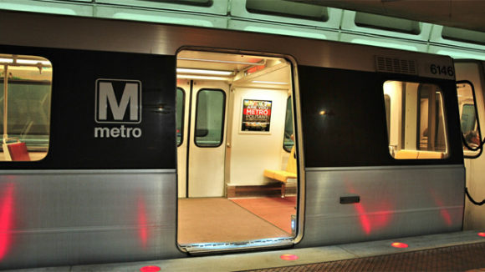
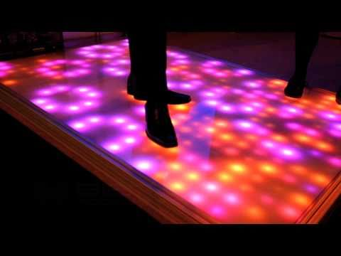

INITIAL BRAINSTORM

Slide 26
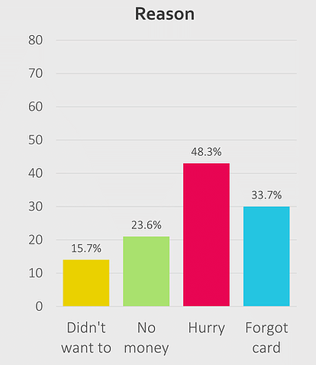
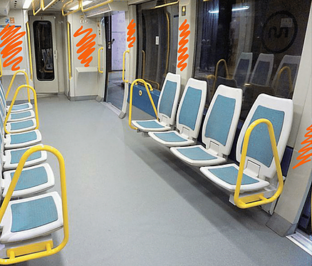



INITIAL FEEDBACK
Inside
validators

Slide 27
1st Iteration

Slide 28
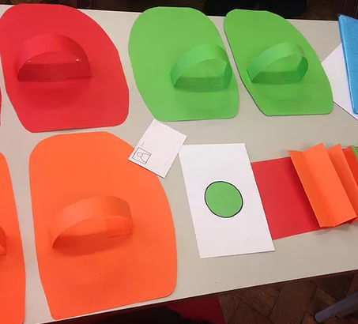
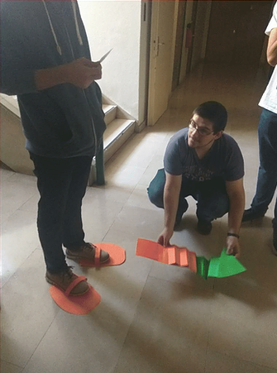
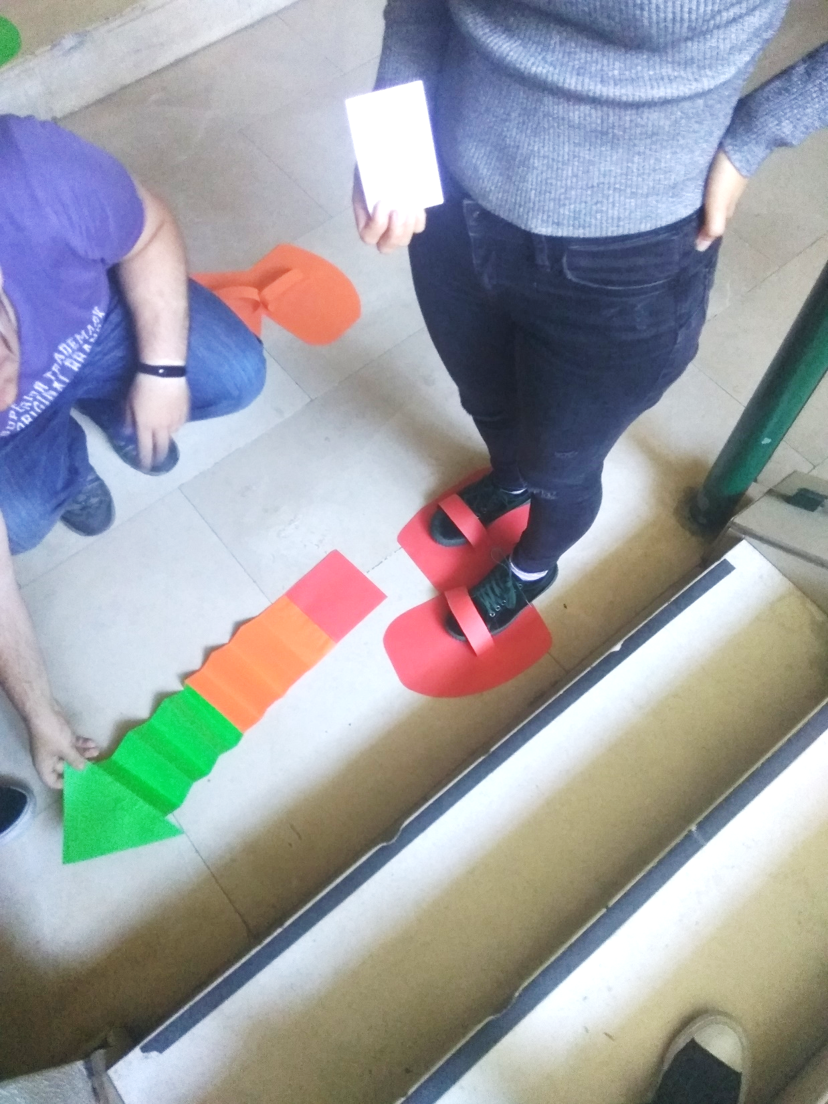

Slide 29
WHAT DID WE LEARN?
POSITIVE FEEDBACK:
Colour code
Easy to understand
Intuitive
TO IMPROVE:
Sound feedback
Tries for validation

Slide 30
2nd Iteration

Slide 31
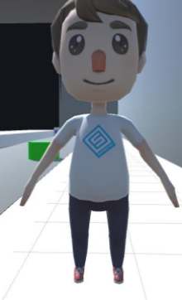
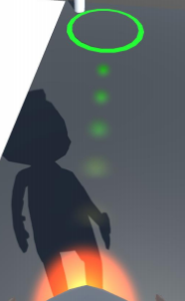
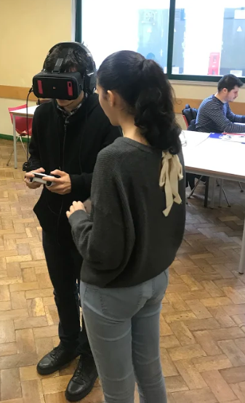

Slide 32
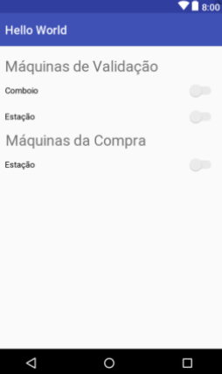
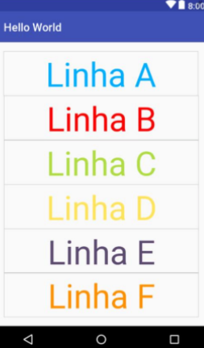
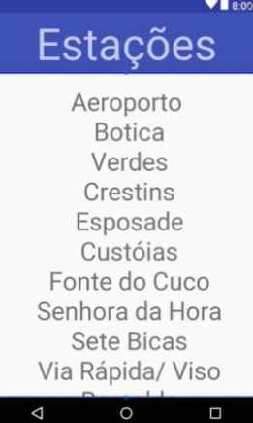

Slide 33
WHAT DID WE LEARN?
POSITIVE FEEDBACK:
Simulation gives good understanding of our idea
App is functional
TO IMPROVE:
App design
Simulation dynamic arrows trail

Slide 34
3rd Iteration

Slide 35
MOST RECENT IMPROVEMENTS
Mostrar app nova

Slide 36

BUDGET SKETCH

Slide 37
BUDGET OVERVIEW
Material | Preço (€)
280 placas de ActiveFloor | 2 240 000
Maintenance
Employees
Licensing and inspections

Slide 38


PILOT & APP
Material | Preço (€)
60 placas de ActiveFloor | 480 000
App | Preço (€)
Project Manager | 3000
Team (5 people) | 11 500
Total: | 14 500

Slide 39
PILOT & APP
Material | Preço (€)
ActiveFloor | 480 000
App | 14 500
Total: | 494 500

Slide 40

Demo

Slide 41
Thank you!
ANY QUESTIONS?
You can find us at:
https://walkinglight.wixsite.com/ccu-group7

